Slide 1
Satellite Routing IETF 116 Hackathon
Huawei & Nanjing University
March 25-31, 2023

Slide 2
Hackathon Plan
Simulation of satellite network based on NS3.
Combine satellite network with existing routing protocols.
Evaluation of existing routing protocols in satellite network.
Path delay variation of satellite network;
Path delay jitter variation of satellite network;
Packet Loss of satellite network;
Path switching of satellite network;

Slide 3



Hackathon Development
Build Enviroment:
OS
Windows10
Hyper-v
10.0
Virtual Machine OS
Ubuntu 20.04
G++/Gcc
9.4
NS3
3.31

Slide 4
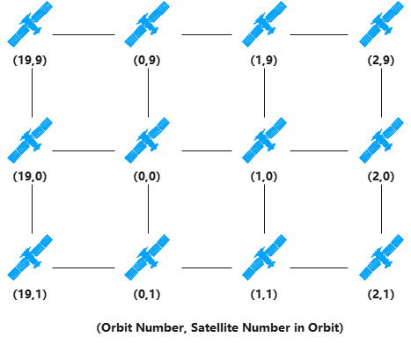
Simulation Introduction
Basic simulation configuration for satellite network.
Topology Configuration
Satellite number: 20*10
Inclination angle: 65°
Altitude：700km
Link bandwidth: 100Mbps
Ground Stations：Shanghai、Nanjing、Los Angeles
Notes:
Reusing locators of SRv6

Slide 5
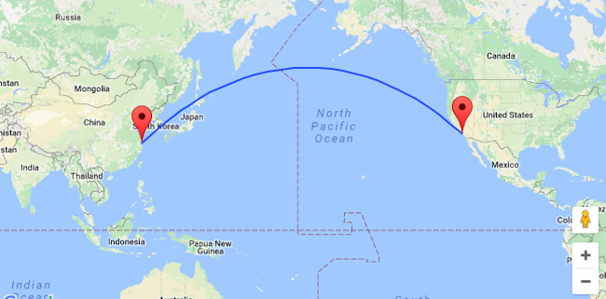
Simulation Introduction
Basic simulation configuration for satellite network.
Traffic Configuration：
Simulation time: 300 seconds
Transport layer protocol: UDP
Sending rate: 2Mbps
Max queue size: 100 pkts
Source：Ground Station in Shanghai
Destination：Ground Station in Los Angeles
Routing protocols：OSPF and AODV
Notes:
Reusing locators of SRv6

Slide 6
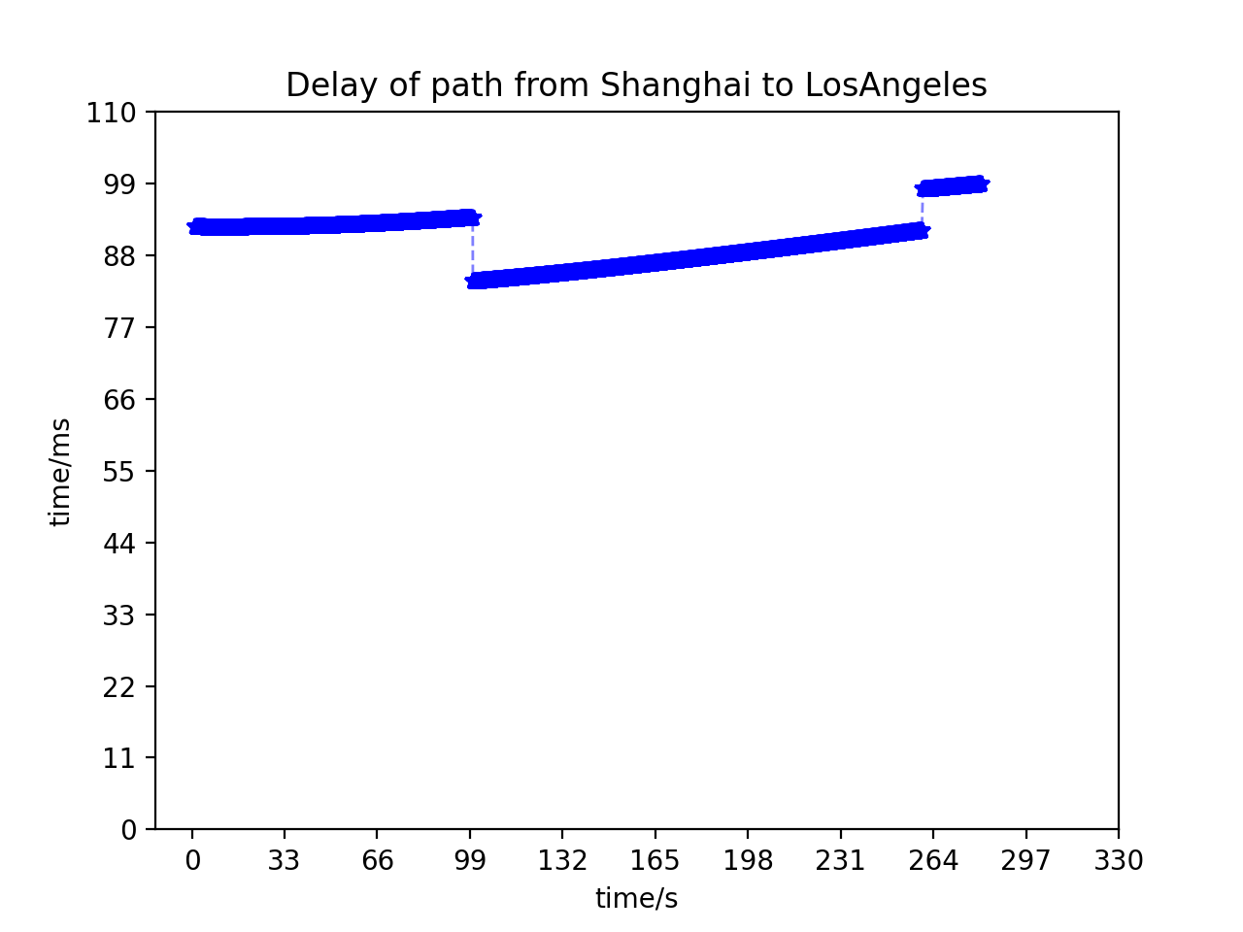
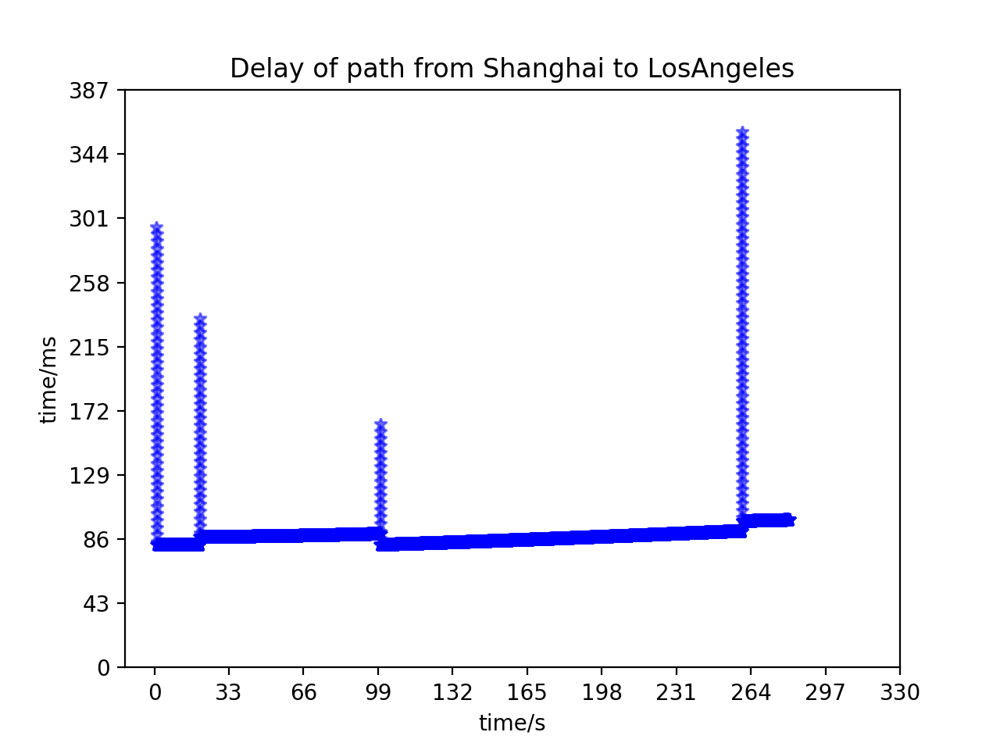
Demo & Result
Result1: Visualization of path delay variation.
OSPF
AODV

Slide 7
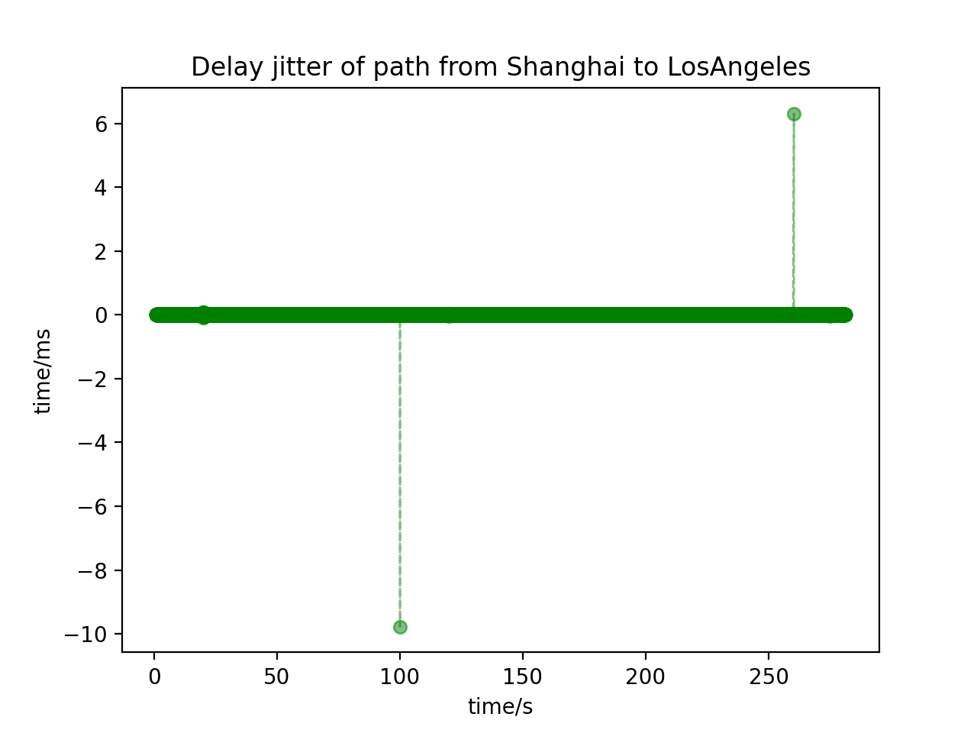
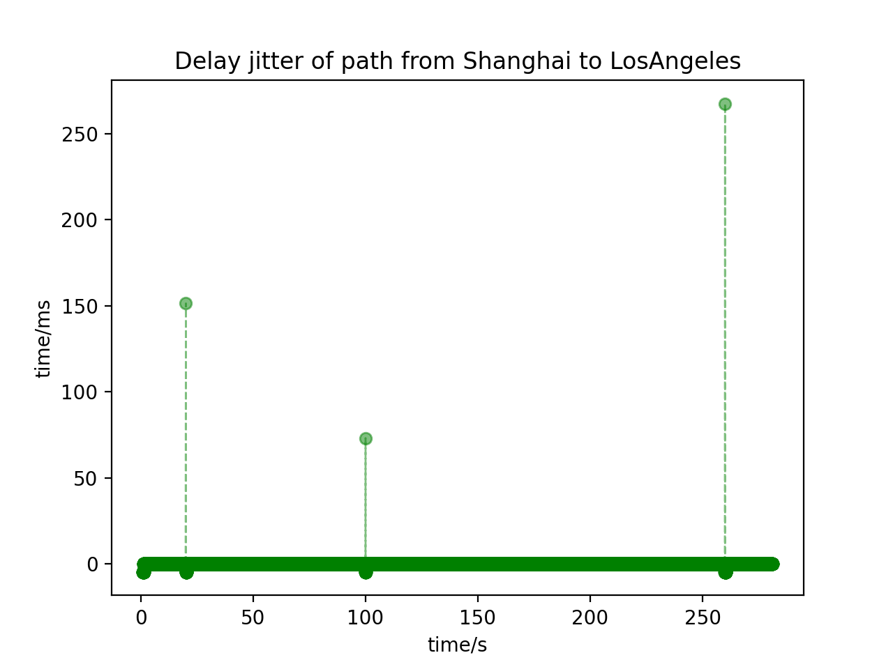
Demo & Result
Result2: Visualization of path delay jitter variation.
OSPF
AODV

Slide 8
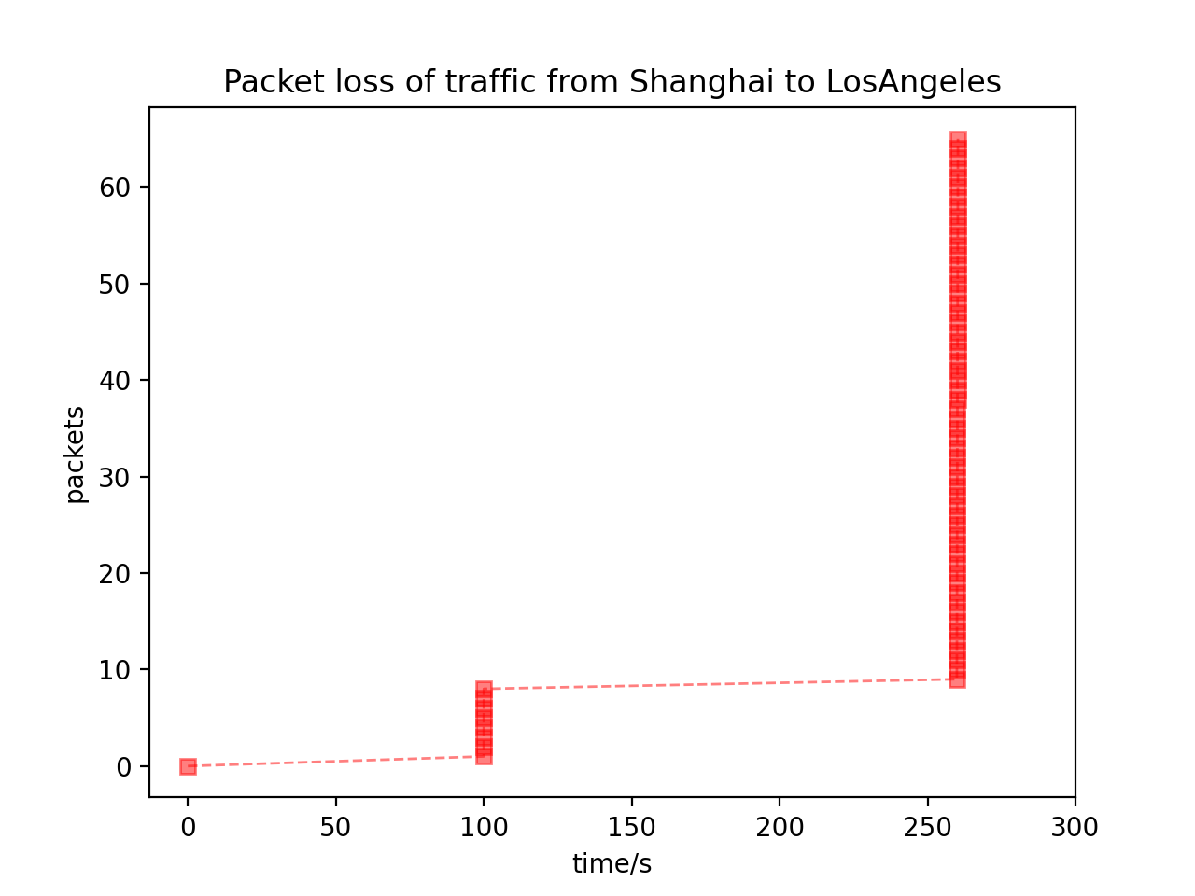
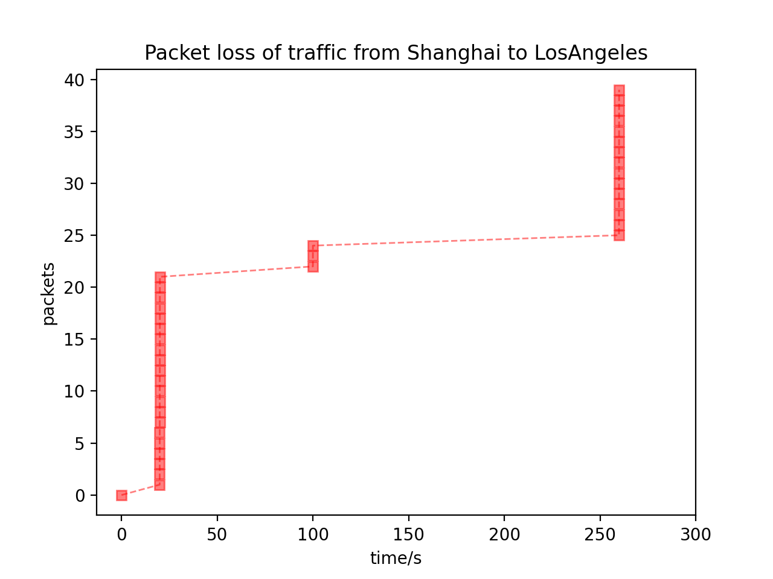
Demo & Result
Result3: Visualization of packet loss.
OSPF
AODV

Slide 9
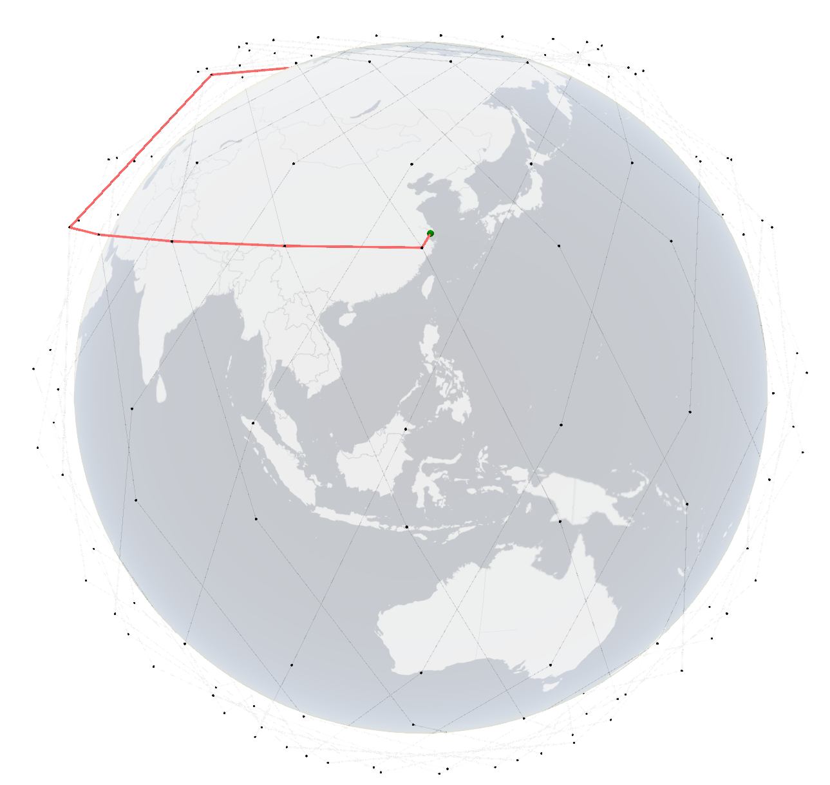
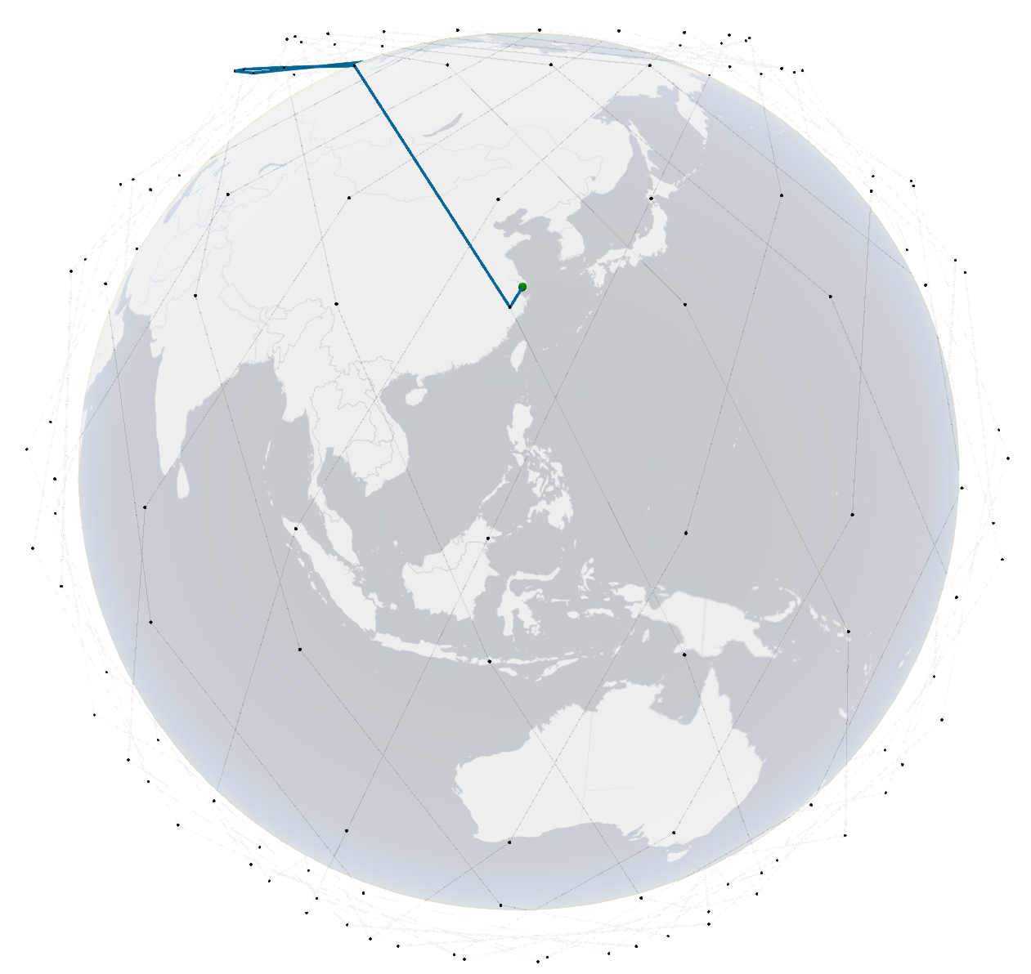
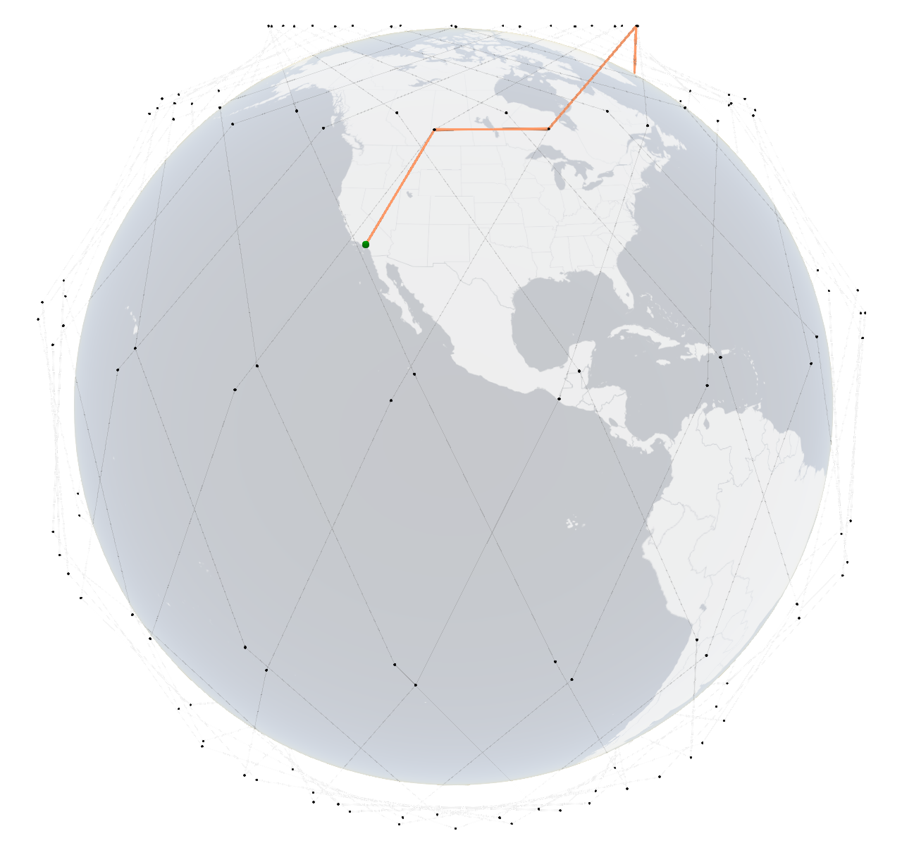
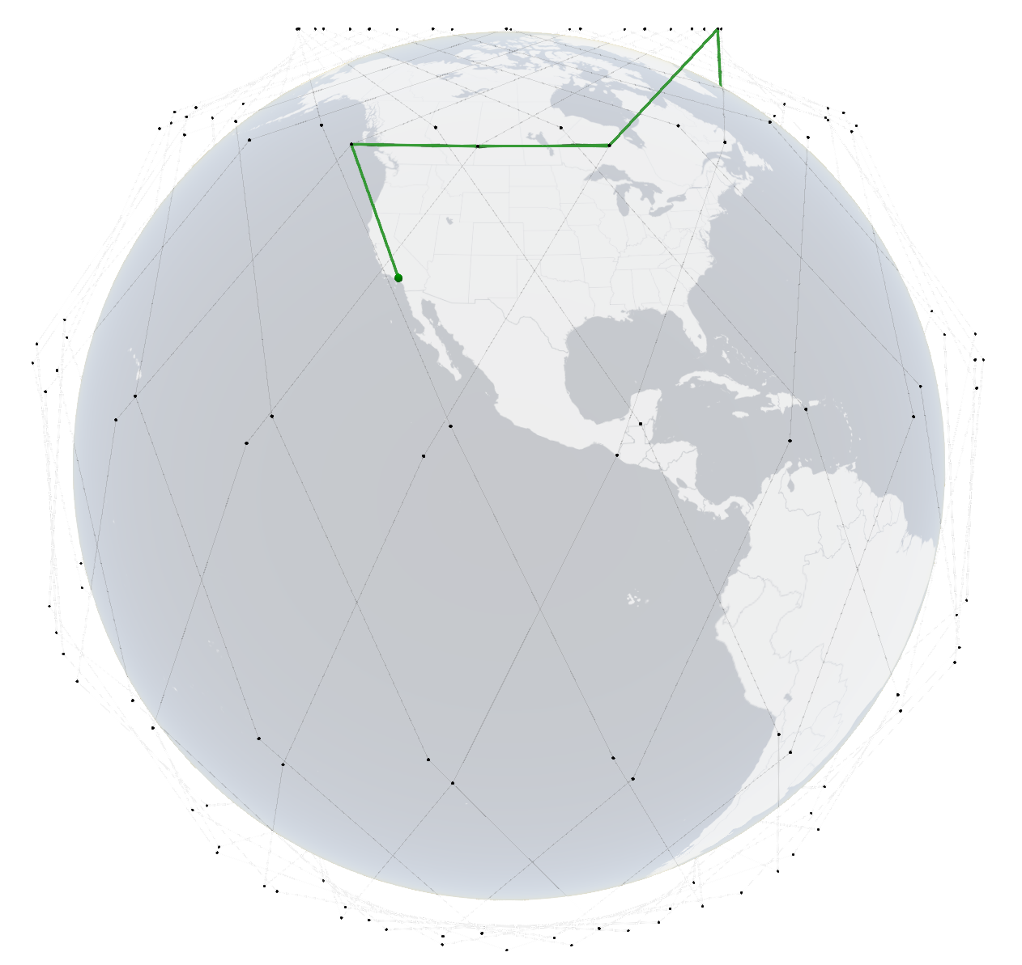
Demo & Result
Result4: Visualization of path switching.
ISL Interrupt
GSL Switch

Slide 10
What we learned
The existing terrestrial routing protocols(OSPF, AODV) can’t adapt to the satellite network and will result in frequent packet loss and Large delay Jitter.
OSPF protocol is better than AODV in the performance of path delay jitter but worse in the packet loss(in this case).
In the future:
Adapt more existing routing protocols to the satellite network.
Improve the existing routing protocols to adapt to the satellite network.
Improve the simulation speed of satellite network.
Cooperate with partners who interest in satellite network, join us to improve it together!
Notes:
http://ceni.org.cn/

Slide 11
Thank you :)
Team members(Huawei):
Zhenbin Li (lizhenbin@huawei.com)
Li Zhang (zhangli344@Huawei.com)
Qiangzhou Gao (gaoqiangzhou@huawei.com)
Open Communities: https://github.com/Satellite-Routing
Team members(NJU):
Haibo Zhou (haibozhou@nju.edu.cn)
Xiaoyu Liu (xyliu0119@163.com）
Ting Ma (majiawan27@163.com)
Zhixuan Tang (zhixuantang@smail.nju.edu.cn)
Xiaohan Qin (xhderemail@smail.nju.edu.cn)
IETF 110 Hackathon: Application-aware G-SRv6 networking

